Slide 1
NOAA L1 Status and Studies
D.A. Biesecker¹, D. Socker²
¹NOAA/SWPC, ²DOD/NRL

Slide 2
Outline
NOAA’s History at L1
ACE
DSCOVR
NOAA’s Future at L1
SWFO
Coronagraph
Requirements
Requirements justification
Cosmic Ray scrubbing
Gap-filler

Slide 3
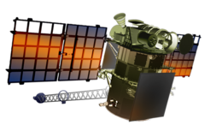
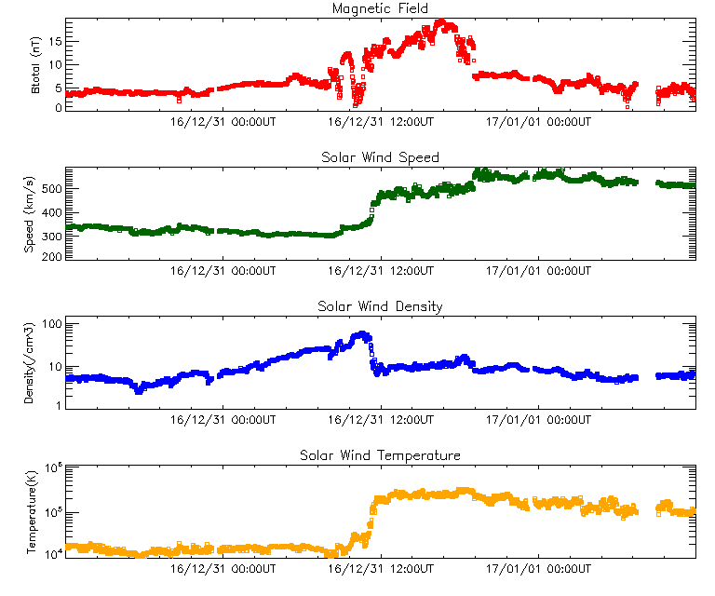
NOAA’s L1 History (ACE & DSCOVR)
1993: NOAA Deputy AA provided funds for RTSW effort
1998: ACE became ‘operational’ for SWPC on 21 Jan 1998
2008: NOAA & USAF funded NASA to pull DSCOVR out of storage
2015: DSCOVR launched 11 Feb 2015
2016: DSCOVR became operational for SWPC 27 Jul 2016

Slide 4
After DSCOVR comes SWFO
NOAA Space Weather Follow-on Program to follow DSCOVR at L1
Highlights of the planned mission are:
Total 10 year operational mission
Two identical spacecraft for long-term continuity
Launches planned for 2022 and 2027
Addition of a coronagraph – Compact Coronagraph (CCOR)
Addition of a suprathermal ion sensor (e.g. ACE/EPAM) 10 keV - 2 MeV
Improved plasma measurements for meeting more stringent user requirements – high plasma velocity (V=2500 km/s)

Slide 5
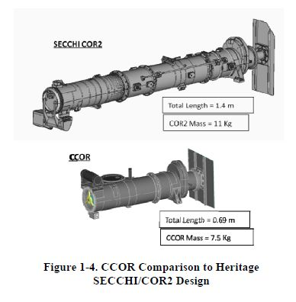
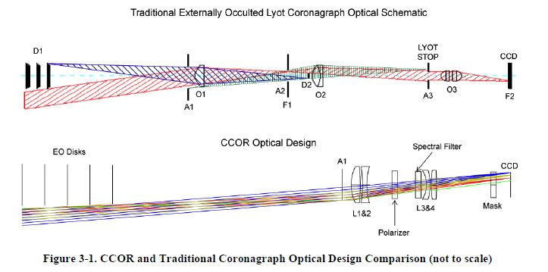
Compact Coronagraph (CCOR)
NRL is in Phase A
System Requirements Review/Concept Design Review held Feb 16, 2017
Phase B begins in April 2017

Slide 6
L1 In-situ Requirements
Parameter | Threshold | Objective
Magnetic Field Vector
Measurement Cadence | 1 vector per minute | 1 vector per second
Magnetic Field Range | 0 to ±200 nT along each axis
Accuracy | ±1 nT up to 100 nT 1% for measurement > 100 nT
Plasma Ion Velocity, Density, and Temperature
Measurement Cadence | 1 measurement per minute | 1 measurement per second
Velocity Range | 200 to 2500 km/s
Density Range | 0.1 to 150 particles per cm^3
Temperature Range | 40,000 to 2,000,000 K
Low Energy Ion Particle Population
Measurement Cadence | 1 measurement every 5 minutes | 1 measurement per minute
Energy Range | 10 to 2,000 keV
Spectral Resolution | 5 differential flux channels per decade
L1 Requirements Workshop held in 2014
In-situ and imaging sessions held in parallel
Requirements (extended range) now cover extreme space weather

Slide 7
Coronagraph Requirements
Field of view range
ΔFOV function of:
# of CME images
CME speed
sampling frequency
Assume fastest CME 3400 km/s
(cf. LASCO catalog)
ΔFOV = (3*3400km/s*15min) =13.2 Rsun
Parameter | Threshold | Objective
Field of View | 3.7-17 R_{SUN} | 3-25 R_{SUN}
Pointing Knowledge | 25 arcsec | 12.5 arcsec
Knowledge of Solar North | 1 degree | 0.5 degree
Spatial Resolution | 50 arcsec (at average of the inner and outer radii of the FOV)
Photometric Accuracy | 10%
Image Cadence | 15 minutes | 5 minutes
Data Latency* | 15 minutes | 5 minutes
*Data Latency is defined as the time from the end of the final exposure in an image, or image sequence, to the time the level 3 processed data are available to forecasters.

Slide 8
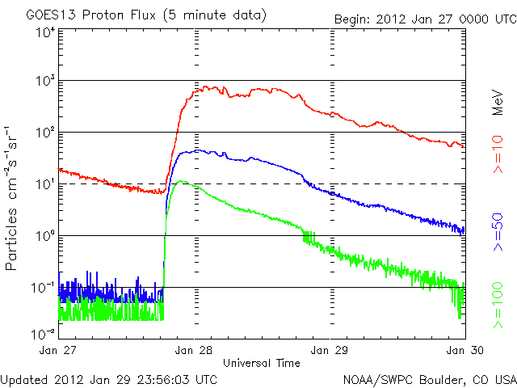
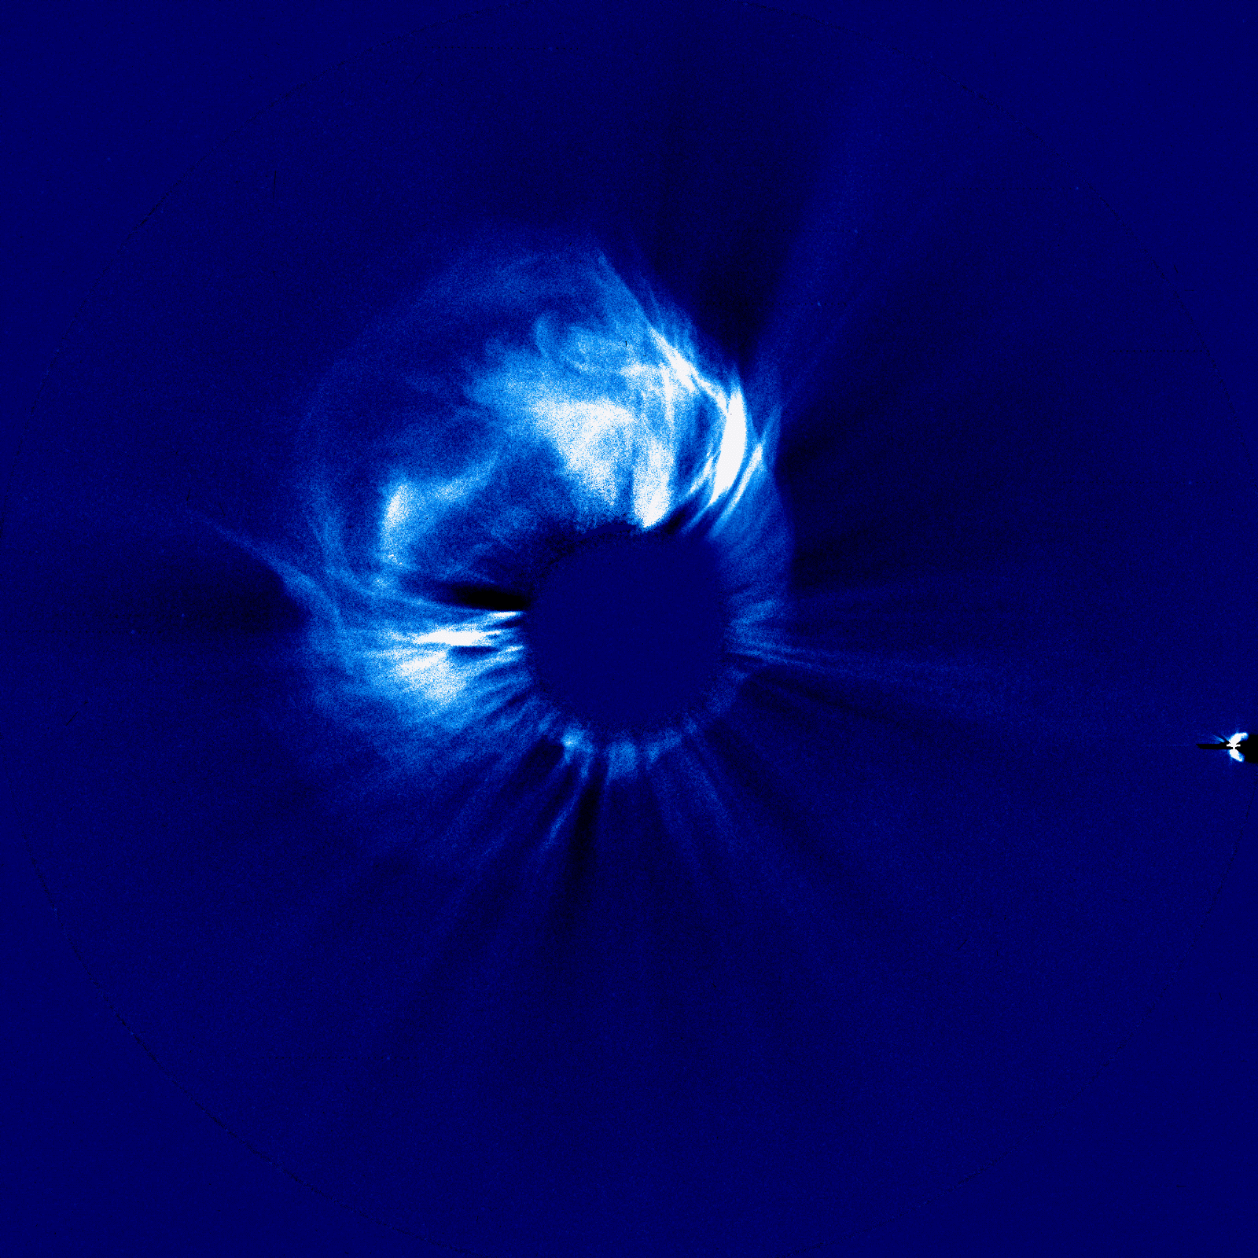
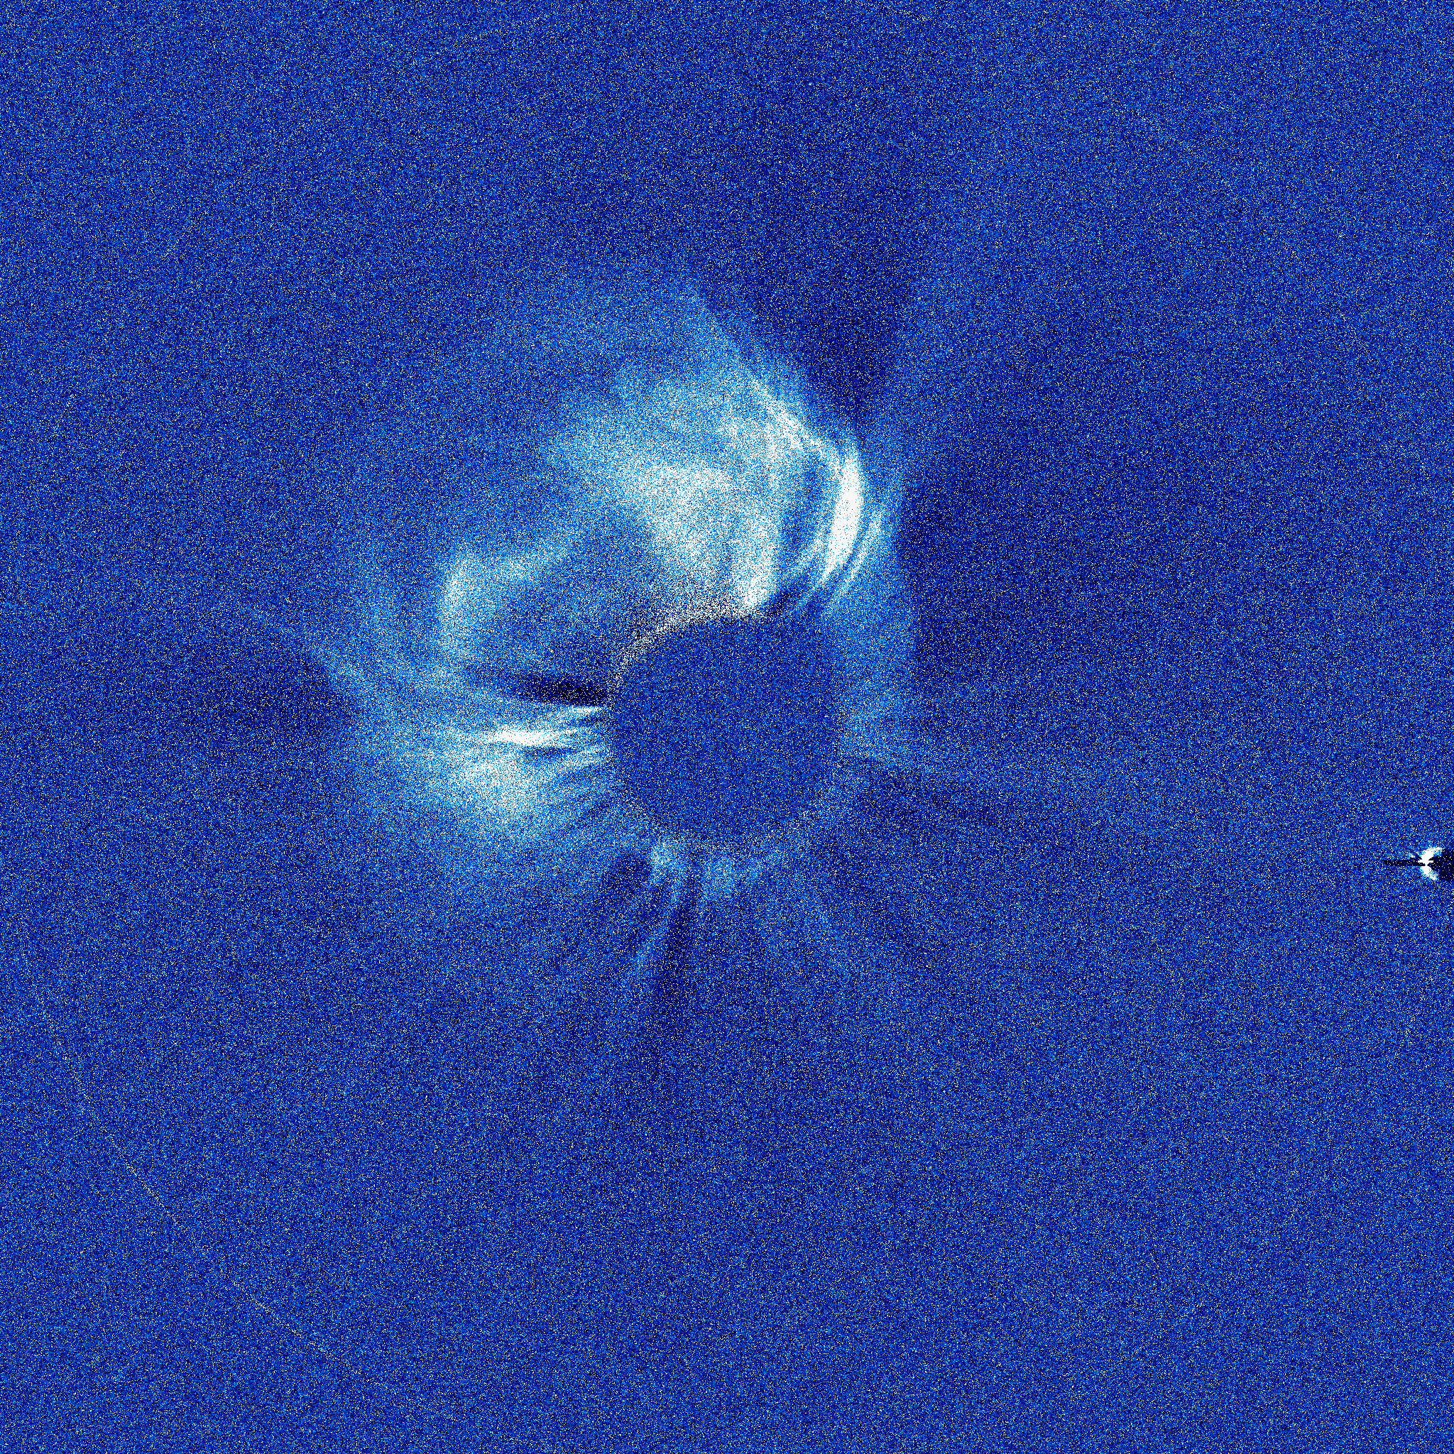
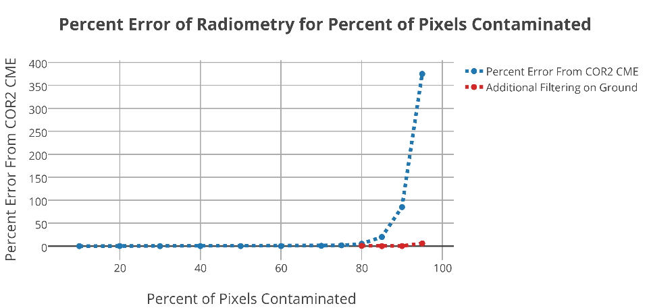
CCOR will see through the ‘clouds’
Current state of the art (COR2)
CCOR
COR2 CME
CME + SEP storm
CME+SEP STORM
STEREO-A COR2 Image of CME (01/27/2012)
90% of pixels effected
90% of pixels effected
Using scrub algorithm

Slide 9
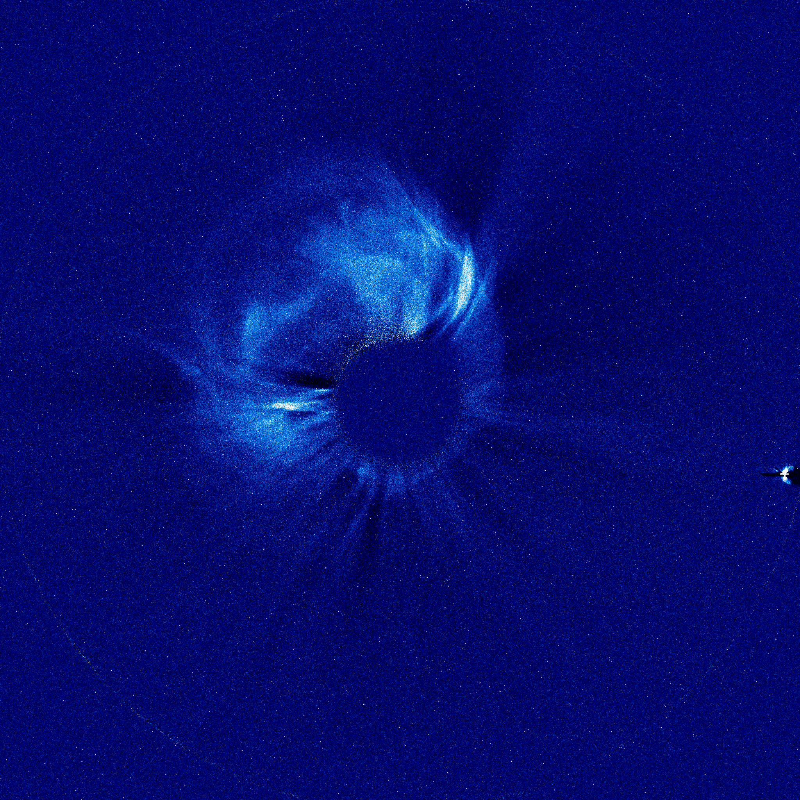
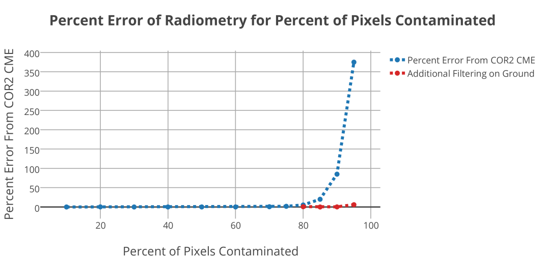
Nominal CCOR Image Quality & Performance
COR2 SEP free CME
75% Contamination
No Scrub
With Scrub
97% of all pixel samples contaminated

Slide 10
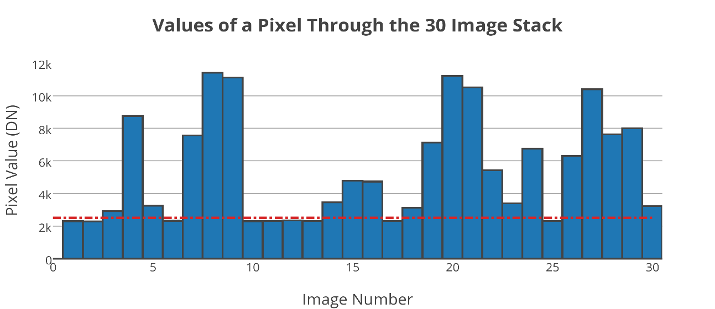
CCOR Scrub Algorithm
For Each Pixel, Go through the Stack of 30 and find the smallest value
Use the minimum pixel value to construct a tolerance for each pixel stack and search for other usable values
Using algorithm run time in C and a series of benchmark programs (whetstone, dhrystone) a 3 minute run-time for CCOR flight computer is estimated.
Notes:
Histogram graph of values edit font size

Slide 11
Gap-Filler Coronagraph
SOHO is nearing the end of it’s lifetime
1000 Watts needed to recover from safe mode
SWFO launch planned for 2022
Risk of no coronagraph data
NOAA exploring options for a CCOR tech demo deployment ~2019
e.g. RFI released in 2016

Slide 12
Summary
Space Weather Follow On, with the first launch in 2022, represents NOAA’s intent to provide continuous monitoring of solar wind data from L1
It also represents the first operational coronagraph
Mission definition for SWFO is at a very preliminary stage
Loss of SOHO before SWFO is operational is a real risk that NOAA is taking seriously

